Slide 1

Analyzing World’s Best Wine Reviews Dataset
Detailed Project Report
Kashish Malviya

Slide 2
Project Detail
Project Title | Analyzing World’s Best Wine Reviews Datasets
Technology | Business Intelligence
Domain | Business Analytics
Project Difficulty Level | Advanced
Programming Language Used | Python
Tools Used | Jupyter Notebook, MS-Excel, MS-Power BI

Slide 3
OBJECTIVE :
The goal of this project is to analyse and visualize the key insights about wine quality,pricing , regions and reviwers prefrences.

Slide 4
PROBLEM STATEMENT
The global wine industry is vast, with thousands of wines reviewed and rated annually. Consumers, sommeliers, and retailers need a structured way to analyze wine ratings, prices, regional trends, and critic preferences. This project aims to develop an interactive Power BI dashboard to visualize and analyze wine reviews, helping users identify top-rated wines, price-value relationships, regional wine trends, and reviewer biases.

Slide 5
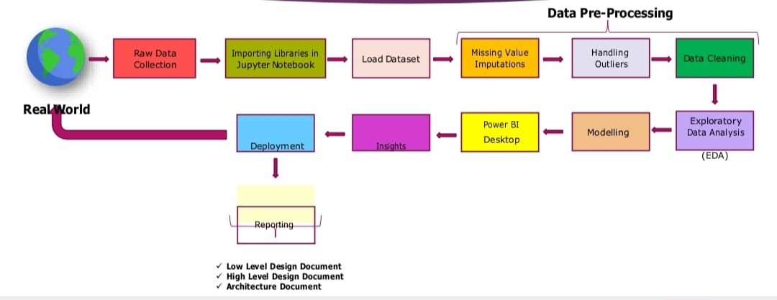
ARCHITECTURE

Slide 6
DATA SET INFORMATION:
1.Country: The country of origin
2.Price : Price of the wine
3.Points: Wine rating (score)
4.Variety: Type of grape used
5. Provience: The region within the country
6.Winery: Name of the winery
7.Description: Text review of the wine
8.Designation, region_1,region_2: Additional location details

Slide 7
WHY THE DATASETS ARE IMPORTANT?
The information in this dataset is important because it provides valuable insights into the wine industry, benefiting consumers, retailers, and producers. Here’s why:
1. Consumer Decision-Making Helps wine enthusiasts choose wines based on quality, price, and region defines the best-value wines by comparing ratings and prices.
2. Industry Trends & Market Analysis Reveals which wine-producing regions are excelling. Highlights trends in wine preferences over time.
3. Business & Marketing Insights Assists wineries and distributors in understanding consumer preferences. Helps restaurants and retailers stock high-rated, cost-effective wines.
4. Critic Influence & Bias Analysis Examines reviewer preferences and scoring patterns. Identifies potential biases in ratings based on price, region, or brand.

Slide 8
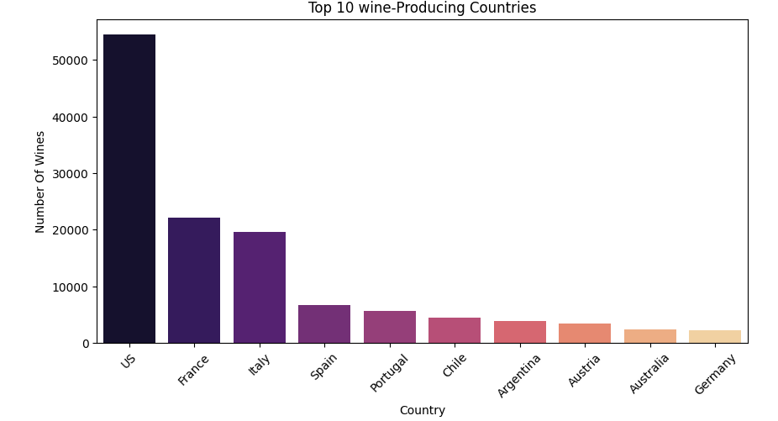
INSIGHTS

Slide 9
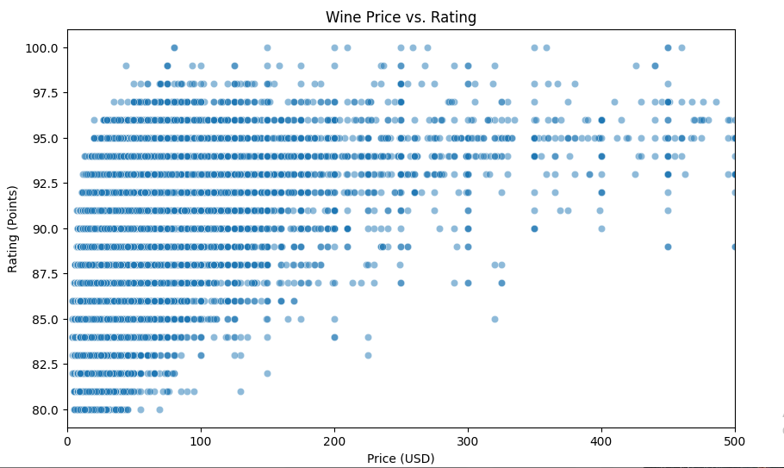

Slide 10
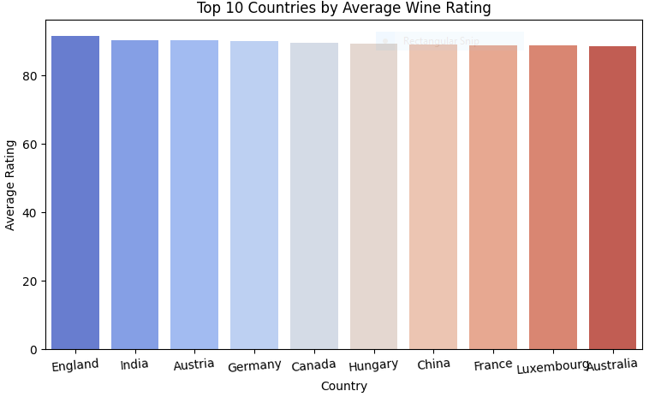
TOP 10 COUNTRIES HAVING AVERAGE WINE RATINGS

Slide 11
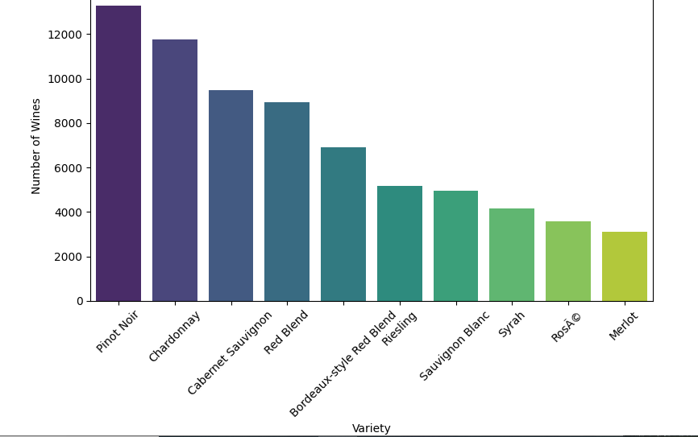
Top 10 varities of wine:

Slide 12
KEY PERFORMANCE INDICATORS (KPI)
Top 10 Highest-Rated Countries producing wines.
Average Wine Rating: The mean score of all wines reviewed.
Percentage of Wines Rated 90+: The proportion of wines with a score above 90 (considered premium).
Average Price per Wine: The mean price of all wines in the dataset.
Best Value Wines: Wines with the highest rating-to-price ratio.
Price Distribution by Rating: Visualizing price trends for different rating levels.
Top 5 Wine-Producing Countries: Based on the number of reviews or high-rated wines.
Average Rating by Country: Comparing wine quality across different regions.
Most Expensive Wine Regions: Locations with the highest average wine prices.

Slide 13
CONCLUSION:
The dataset contains over 150,000 wine reviews with ratings (points) ranging from low to high.
Many wines have received 90+ ratings, indicating a strong representation of high-quality wines.
The dataset includes price data for ~137,000 wines, though some entries are missing.
There are premium wines (e.g., priced above $200) with high ratings, but also affordable wines that receive high scores.
Wines from the US, Spain, and France appear frequently in the dataset.
The province and region columns provide deeper insights into wine-producing areas, such as Napa Valley, Willamette Valley, and Northern Spain.
The dataset covers a wide range of wine varieties, including Cabernet Sauvignon, Pinot Noir, and Sauvignon Blanc.
Some wines have a designation (specific vineyard or brand name), but this field has missing values for many entries.
Each review includes the winery name, allowing analysis of the top producers of high-rated wines.

Slide 14
Q & A
Q1.What is the source of the data?
Ans: https://www.kaggle.com/datasets/zynicide/wine-reviews
Q2: What was the type of data?
Ans: The data was the combination of numerical and categorical values.
Q3: What techniques were you using for data?
Ans: Removing unwanted attributes
Removing outliers
Cleaning data and imputing if null values are present .
converting Numerical into categorical values.
Q4: What were the libraries that you used in python?
Ans: I used Pandas, NumPy ,Matplotlib and Seaborn libraries .

Slide 15
THANK YOU

